Slide 1
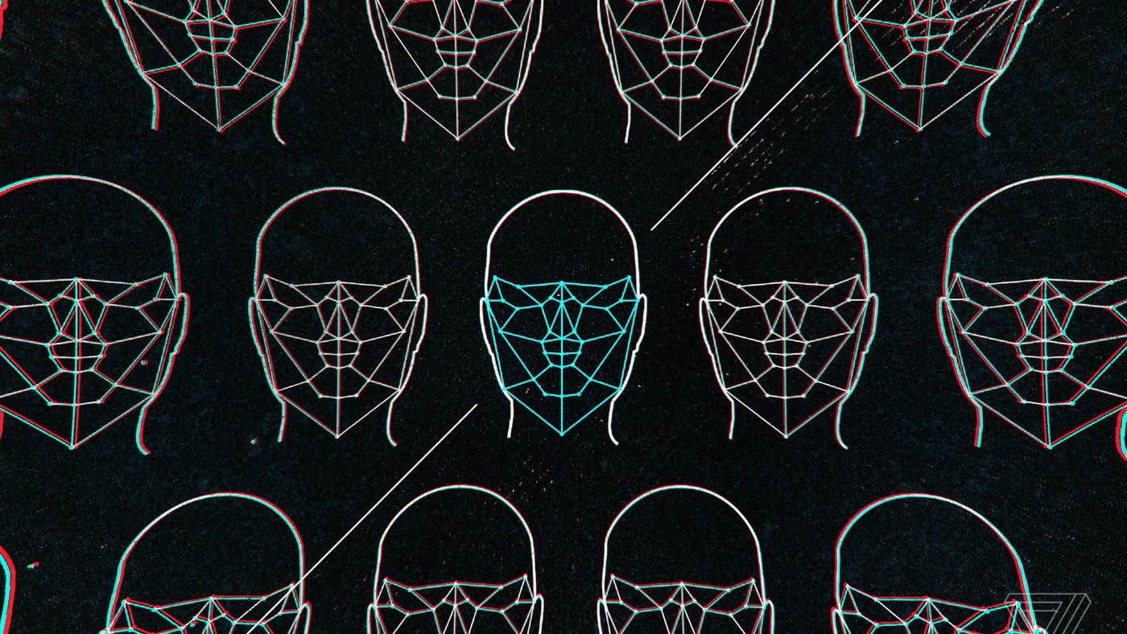

TRUE FACE
Facial Recognition Project
By:
SAYAN DEBNATH (2210993844)
JANNAT KAUR CHEEMA (2210993796)

Slide 2
PROBLEM STATEMENT
In the modern age of social media, we see hundreds and thousands of faces daily, and because of this overexposure of new faces, sometimes It gets hard to recognize someone through their face alone.
In addition to this, when identity theft is widespread, face recognition technology can play a vital role in preventing identity fraud.
To prevent this, face recognition has proven to be a powerful tool to authenticate the identity of an individual.

Slide 3
INTRODUCTION
FACE RECOGNITION
Face recognition is an amazing technology used to find and verify the identity of an individual using their face. Face Recognition systems can be used to identify people in photo, video and real-time. It avails computer algorithms to pick out specific, distinctive details about a person’s face.
Face recognizers that are based on landmarks take face images and try to find essential feature points such as eyebrows, corners of the mouth, eyes, nose, lips, etc.
Face detection has progressed from rudimentary computer vision techniques to advances in machine learning (ML) to increasingly sophisticated artificial neural networks (ANN) and related technologies; the result has been continuous performance improvements. It now plays an important role as the first step in many key applications -- including face tracking, face analysis and facial recognition. Face detection has a significant effect on how sequential operations will perform in the application

Slide 4
INTRODUCTION
SOME INDUSTRIAL APPLICATIONS OF FACIAL RECOGNITION
Retail: Could be used to capture what the shoppers are looking at. This will help retailers to enable optimized promotions to the shoppers via email or online ads.
Hotel: By tying this technology to a guest’s account, hotels can activate/her check-ins when they walk into the premises.
Banking: It assists in preventing unauthorized persons from acquiring access to restricted areas of a bank and capturing unusual activity on camera.
Automobile: In an effort to improve convenience and safety, car unlocking & theft protection.
Ride Sharing: Facial recognition software can monitor for signs of tiredness in ride-sharing drivers and prevent them from accepting rides if they are weary. It’s also beneficial in reducing the rate of road accidents caused by fatigued cab drivers.

Slide 5
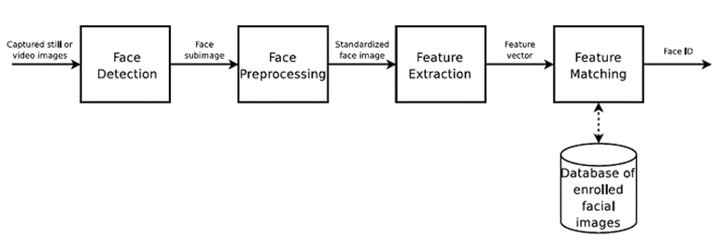
STEPS INVOLVED IN FACIAL RECOGNITION
Face Detection: Locate the face, note the coordinates of each face located and draw a bounding box around every faces.
Face Alignments. Normalize the faces in order to attain fast training.
Feature Extraction. Local feature extraction from facial pictures for training, this step is performed differently by different algorithms.
Face Recognition. Match the input face with one or more known faces in our dataset.

Slide 6
Face, eye Detection and Smile Detection:
The problem of face detection has been studied extensively and this calls for advancement of technology. Therefore, we have developed image processing technology based on Automatic Vision Object Tracking. The analysis of face detection would be using our default PiCAM.
Face detection applications use algorithms and ML to find human faces within larger images, which often incorporate other non-face objects such as landscapes, buildings and other human body parts like feet or hands. Face detection algorithms typically start by searching for human eyes -- one of the easiest features to detect. The algorithm might then attempt to detect eyebrows, the mouth, nose, nostrils and the iris. Once the algorithm concludes that it has found a facial region, it applies additional tests to confirm that it has, in fact, detected a face.To help ensure accuracy, the algorithms need to be trained on large data sets incorporating hundreds of thousands of positive and negative images. The training improves the algorithms' ability to determine whether there are faces in an image and where they are.
A wide spectrum of techniques have been used including color analysis and model base detection, etc.
It is difficult to design algorithm which works for all illumination, face color, size and geometries, and Image background.
A smile Is facial expression formed by muscles movement at the corners of the mouth. Therefore, It will detect the corners of the mouth and determine the outcomes.

Slide 7
CHALLENGES FACED / FURTHER IMPROVEMENTS
There are some challenges that are faced by the Facial Recognitions System:
Illumination: It changes the face appearance drastically, it is observed that the slight changes in lighting conditions cause a significant impact on its results.
Pose: Facial Recognition systems are highly sensitive to the pose, Which may result in faulty recognition or no recognition if the database is only trained on frontal face view.
Facial Expressions: Different expressions of the same individual are another significant factor that needs to be taken into account. Modern Recognizers can easily deal with it though.
Low Resolution: Training of recognizer must be done on a good resolution picture, otherwise the model will fail to extract features.
Aging: With increasing age, the human face features shape, lines, texture changes which are yet another challenge.

Slide 8

REFERAL LINK :
opencv/data/haarcascades at master · opencv/opencv · GitHub
What is Face Detection and How Does It Work? (techtarget.com)
Real-time embedded eye detection system - ScienceDirect

Slide 9
THANK YOU

